Slide 1


0
10
9
8
7
6
5
4
3
2
1

Slide 2

Robotics Corner

Slide 3
Mapping

Slide 4
01
Importance of mapping
02
SLAM
AGENDA
03
Building a Map
04
Simulation

Slide 5


Mapping in ROS
Mapping and gmapping
01285960031
01285960031
www.roboticscorner.tech

Slide 6
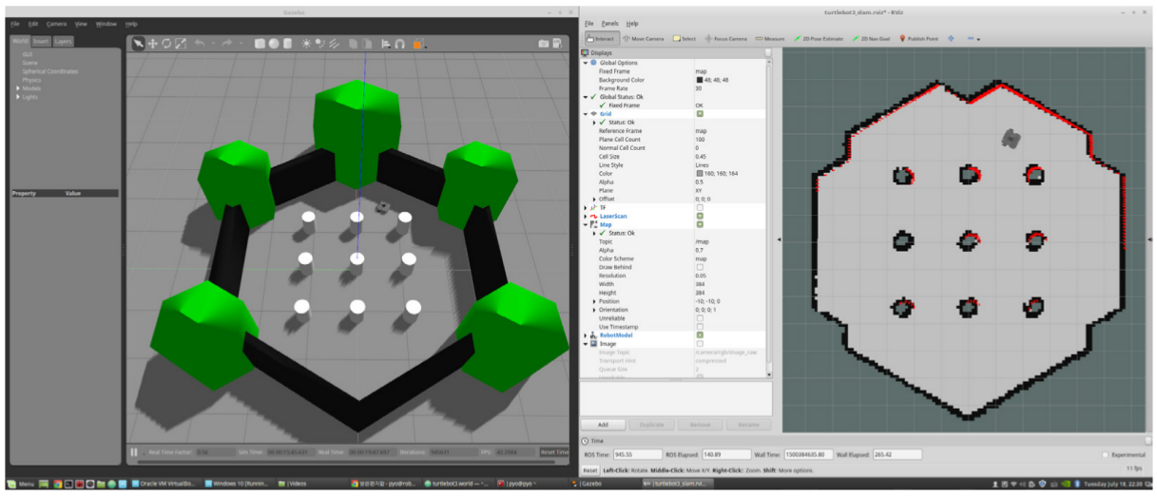
01
Importance of mapping
Sense - Plan - Act
To accomplish a task, a robot should “understand” the environment from its sensor measurements.
Understanding: capturing the information at the right level of abstraction.
An autonomously navigating robot should know
what the environment looks like
where it is in the environment
Have a static map to compare
01285960031
01285960031
www.roboticscorner.tech

Slide 7
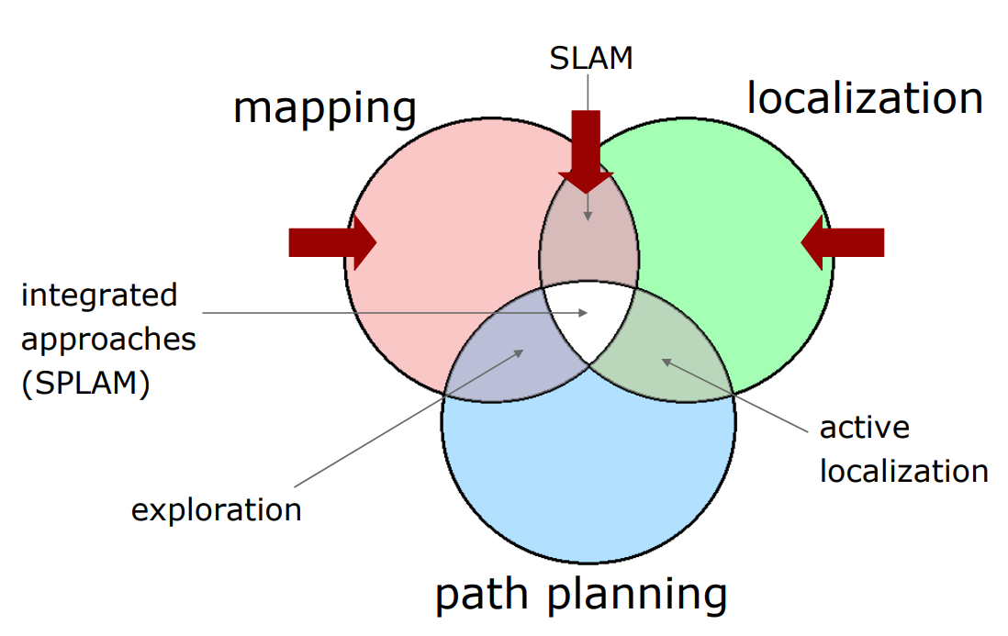
01
Importance of mapping
01285960031
01285960031
www.roboticscorner.tech

Slide 8
Mapping
01
Importance of mapping
Given a robot that has a perfect ego- estimate of the position, and a sequence of measurements, determine the map of the environment.
A perfect estimate of the robot pose is usually not available.
Instead we solve a more complex problem: Simultaneous Localization and Mapping (SLAM).
01285960031
01285960031
www.roboticscorner.tech

Slide 9
SLAM
02
SLAM
SLAM= Simultaneous Localization and Mapping
Estimate:
the map of the environment
the trajectory of a moving device
using a sequence of sensor measurements.
01285960031
01285960031
www.roboticscorner.tech

Slide 10
Building a Map
03
Building a map
There are gazillions of SLAM algorithms around.
ROS uses GMapping, which implements a particle filter to track the robot trajectories.
To build a map you need to Record a bag with /odom, /scan/ and /tf while driving the robot around in the environment it is going to operate in
Play the bag and the gmapping-node (see the ros wiki and the live demo), and then save it.
The map is an occupancy map, and it is represented as An image showing the blueprint of the environment
A configuration file (yaml) that gives meta information about the map (origin, size of a pixel in real world)
01285960031
01285960031
www.roboticscorner.tech

Slide 11
Occupancy Grid Mapping
03
Building a map
Occupancy Grid Mapping refers to a family of computer algorithms in probabilistic robotics for mobile robots which address the problem of generating maps from noisy and uncertain sensor measurement data, with the assumption that the robot pose is known.
The basic idea of the occupancy grid is to represent a map of the environment as an evenly spaced field of binary random variables each representing the presence of an obstacle at that location in the environment. Occupancy grid algorithms compute approximate posterior estimates for these random variables
01285960031
01285960031
www.roboticscorner.tech

Slide 12
gmapping
03
Building a map
This package contains a ROS wrapper for OpenSlam's Gmapping. The gmapping package provides laser-based SLAM (Simultaneous Localization and Mapping), as a ROS node called slam_gmapping. Using slam_gmapping, you can create a 2-D occupancy grid map (like a building floorplan) from laser and pose data collected by a mobile robot.
To make a map from a robot with a laser publishing scans on the base_scan topic:
rosrun gmapping slam_gmapping scan:=base_scan
Instead of base_scan you can write the topic you are publishing your scans on like “/scan” for example
01285960031
01285960031
www.roboticscorner.tech

Slide 13
04
Simulation
Keep in mind that in order for the scans and map to appear in rviz you should add the topics
Add “laserScan” to rviz and make sure that the topic you subscribe to is the laser topic “/scan” for example
Add “map” to rviz and make sure that the topic you subscribe to is the map topic “/map”
And make sure that the tf tree is connecting between:
map-> odom->base_link-> then the rest of the links
01285960031
01285960031
www.roboticscorner.tech

Slide 14
RVIZ configuration
04
Simulation
01285960031
01285960031
www.roboticscorner.tech

Slide 15
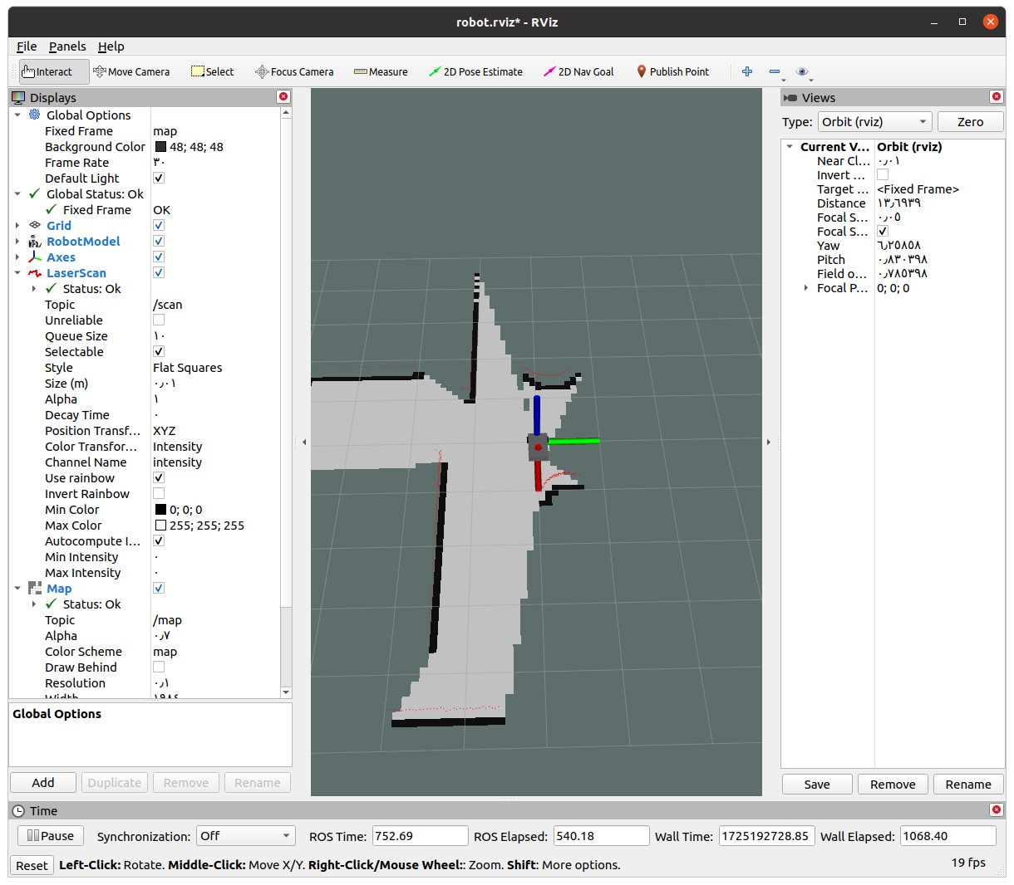
04
Simulation
01285960031
01285960031
www.roboticscorner.tech

Slide 16
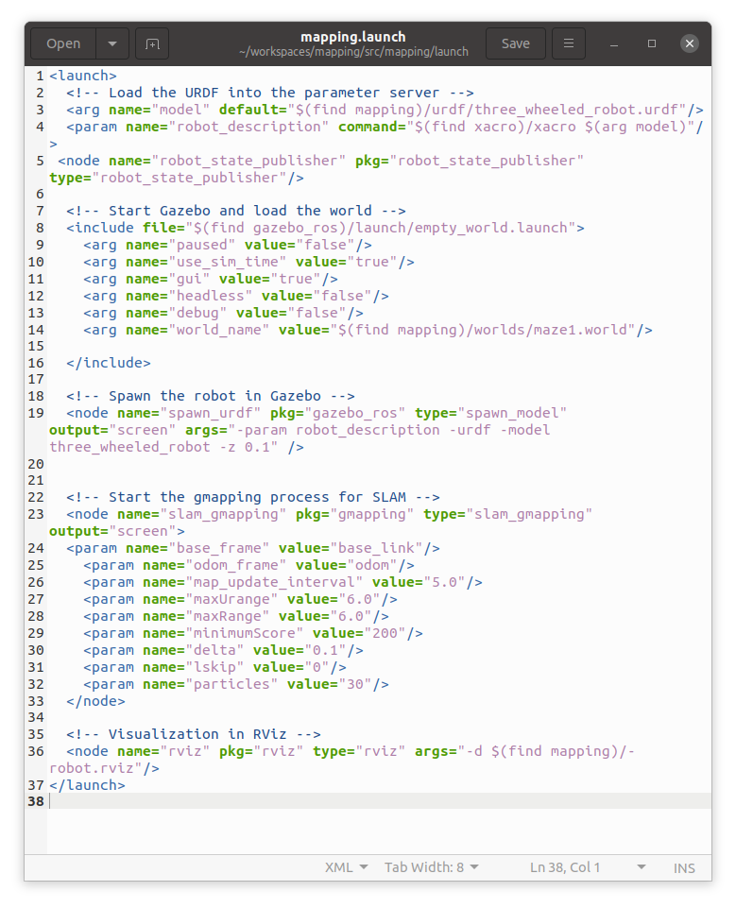
Launch file
04
Simulation
You can make a launch file to launch the gmapping node with rviz and gazebo world directly instead of opening a lot of terminals.
01285960031
01285960031
www.roboticscorner.tech

Slide 17
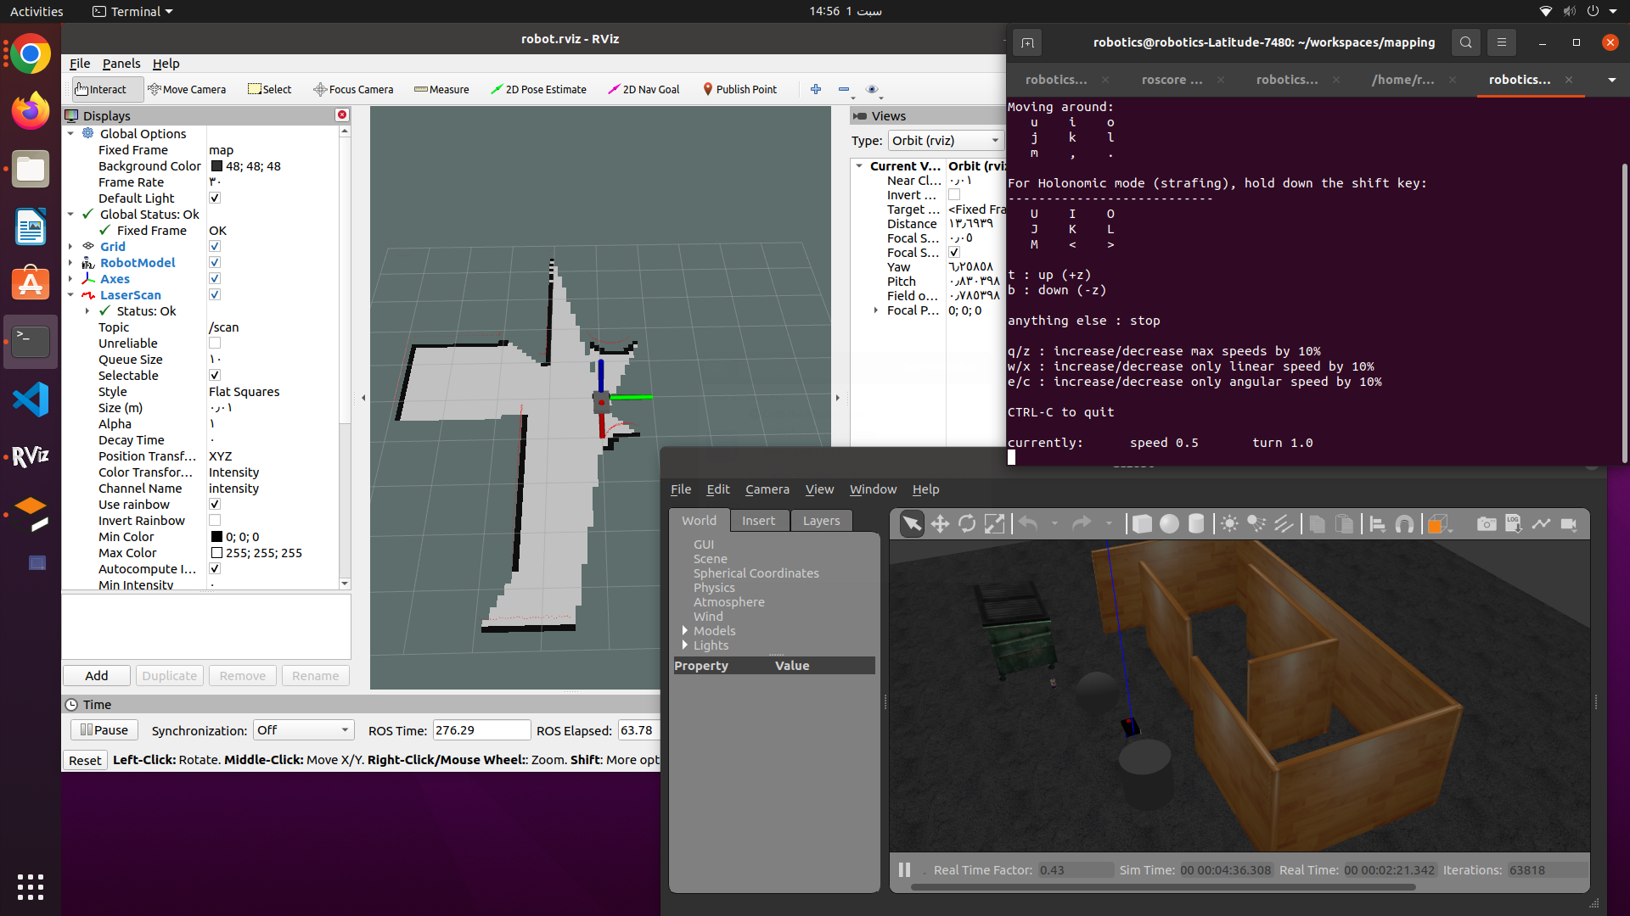
04
Simulation
01285960031
01285960031
www.roboticscorner.tech

Slide 18
Saving the map
04
Simulation
We use map_server package to save the map after drawing it, first you will install it if not already installed:
sudo apt-get install ros-noetic-map-server
And then use the package to save the map.
rosrun map_server map_saver -f mymap
Instead of “mymap” you write the path you want to save your map in, if you write a name directly it will be saved in the location you opened in the terminal
If you want to save it in the package you can write “~/workspacename/src/packagename/map/mapName”
01285960031
01285960031
www.roboticscorner.tech

Slide 19
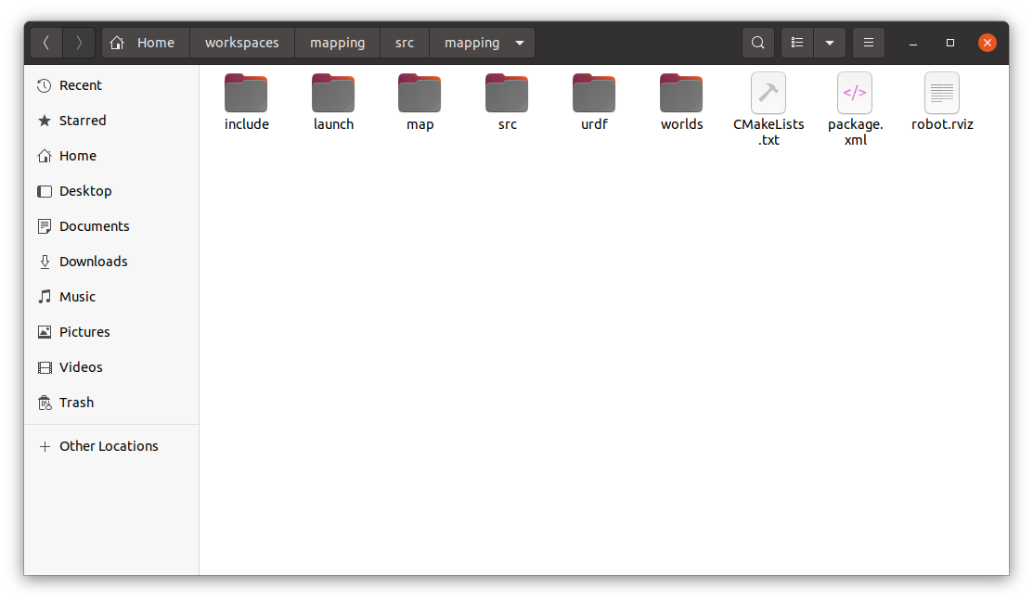
File structure
04
Simulation
01285960031
01285960031
www.roboticscorner.tech

Slide 20
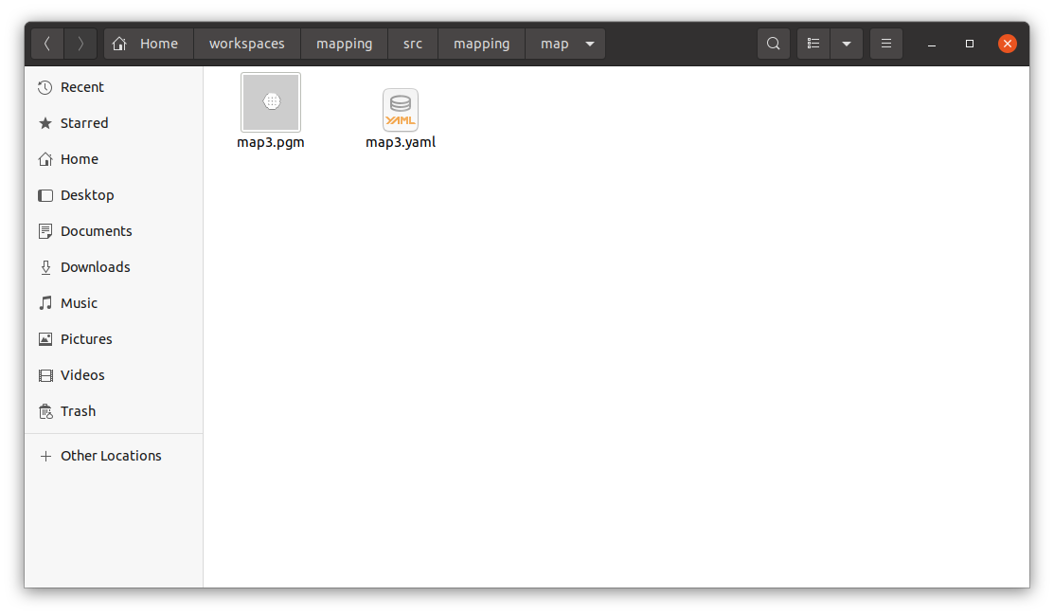
04
Simulation
map files after saving
Generating the map results in 2 files:
Yaml file
Pgm file (photo)
01285960031
01285960031
www.roboticscorner.tech

Slide 21
Yaml file:
04
Simulation
YAML Ain't Markup Language (YAML) is a data serialization language that is consistently listed as one of the most popular programming languages. It's often used as a format for configuration files.
Yaml files consists of sets of keys and values according to the configuration variables you want to set.
01285960031
01285960031
www.roboticscorner.tech

Slide 22



Slide 23

01211626904
www.roboticscorner.tech
Robotics Corner
Robotics Corner
Robotics Corner
Robotics Corner

